Slide 1
Refractive Index

Slide 2

By the end of this lesson, you should be able to:
Define the term refractive index.
Identify how a light ray will bend when it passes between substances that have different refractive indices.

Slide 3
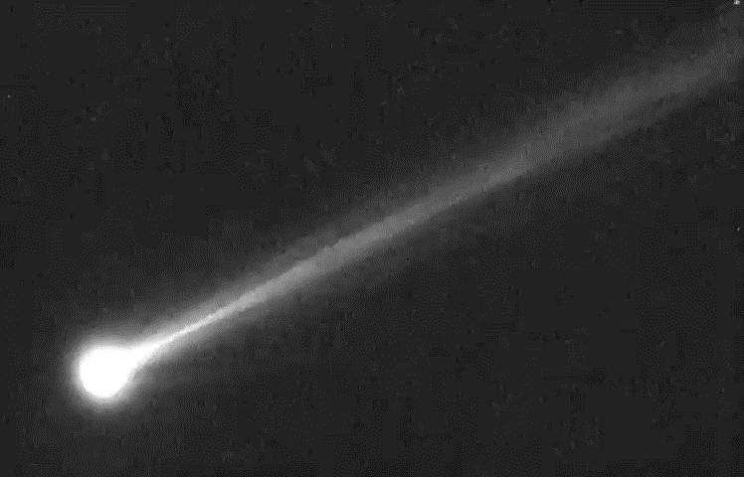
A vacuum has a refractive index of 1.00.
This is the lowest possible refractive index.
A vacuum is the easiest medium to travel through because it contains the least particles of any medium. In fact, it contains no particles, meaning that light travels through it unhindered.

Slide 4
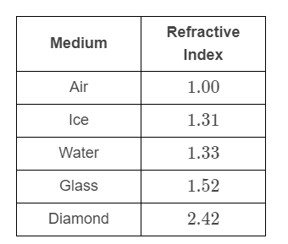
The table below shows the refractive indices of some common media.
The higher a refractive index is, the more light refracts as it enters the substance.

Slide 5
You may have noticed that air and a vacuum both have a refractive index of 1.00.
This isn't quite right. Air actually has a refractive index of 1.0003, but it is rounded to two decimal places.
This means that light travels slightly slower in air than in a vacuum.

Slide 6
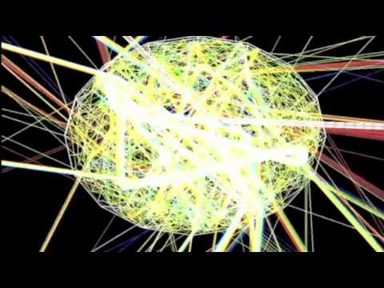

Slide 7
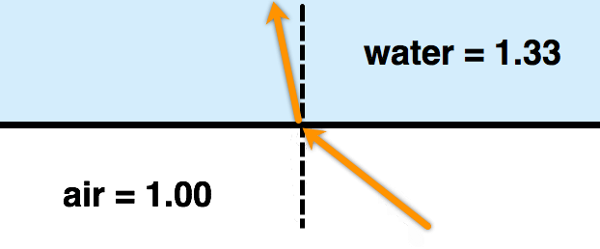
Light travels slower in media with higher refractive indices.
This means that the light ray bends towards the normal when it travels into a medium with a higher refractive index, and vice versa.

